Slide 1
Stansbury Service Agency Board Business Meeting
September 27, 2023

Slide 2
Agenda
Order of Business
Call to Order
Roll Call
Pledge of Allegiance
Sheriff Report
Fire Chief Report
Open Forum for Public Comment
Staff Updates and Reports
General Manager Update
Action Items
2023.09.01 A
  Board review and possible approval of August 9, 2023, Work Meeting Minutes
2023.09.02 A
  Board review and possible approval of August 23, 2023, Business Meeting Minutes
2023.09.03 A
  Board review and possible approval of September 13, 2023, Work Meeting Minutes
2023.09.04 A
  Discussion of Oscarson Bathroom
  Public Comment on Oscarson Bathroom
  Board Review and Possible Approval of Oscarson Bathroom
2023.09.05 A
  Presentation of Fee Schedule
  Public Comment on Fee Schedule
  Board review and possible approval of Fee Schedule
2023.09.06 A
  Discussion on increasing the tax rate to 0.0014 to account for increased operating expenses and deferred maintenance. This is an increase of 104% from $1,537,508 to $3,017,588 over the state’s proposed rate. The rate of 0.0014 would restore the original rate authorized by the county, which has been decreasing over time.
  Board review and possible approval of proposed Tax Rate
Board Member Reports and Discussion Items
Board Member Reports and Concerns
Adjourn
Closed Session to discuss personnel, pending or threatened litigation, or property acquisition (as needed)

Slide 3

Public Comment

Slide 4
General Manager Update

Slide 5
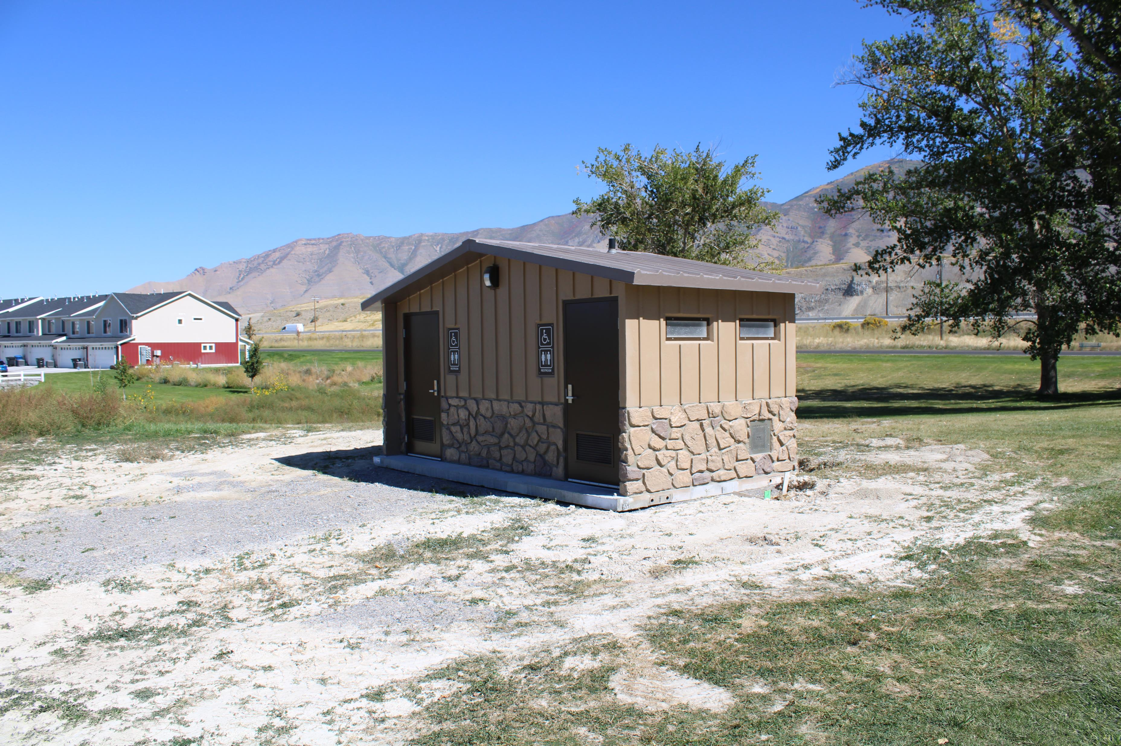
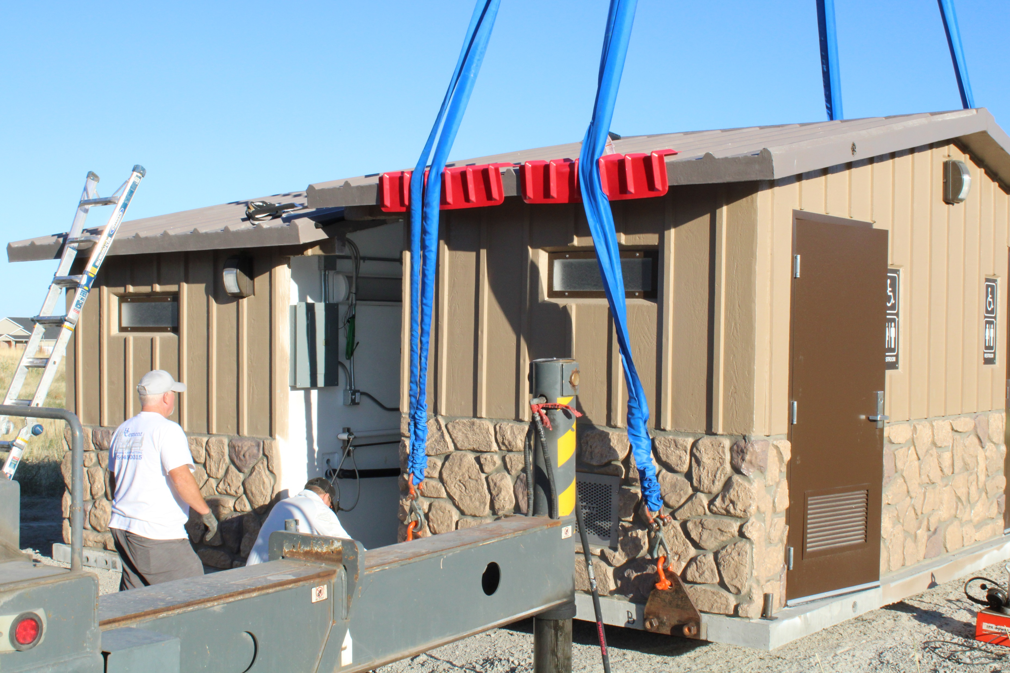
Bathrooms for Oscarson, Porter Way and Millpond Parks

Slide 6
GM Updates
Bathrooms for Millpond, Porter Way and Oscarson Parks
Soundwall Trail and Millpond Parking Lot
  Ensign Design Work
  County Engineering Requirement
  Tooele Roads Integration
Shoreline Improvements
  Second Set of Docks Delivery
  Delgada Park Design
Solomon Park
  Phase I completed except for some rock landscaping
  Bids for Phase II
Internal Audit of Pro Shop
DWR

Slide 7
Library Update
No money in current budget for staff
  Need at least one part time employee for grants
    $20K - Options
Final certification requirements
    Tooele County Ownership increases requirement level
    Best Case is for Stansbury to Incorporate
    Need to update Interlocal Agreement to encompass Library

Slide 8
Financial Summary

Slide 9
Approval Of Minutes

Slide 10
Oscarson Park Bathroom

Slide 11
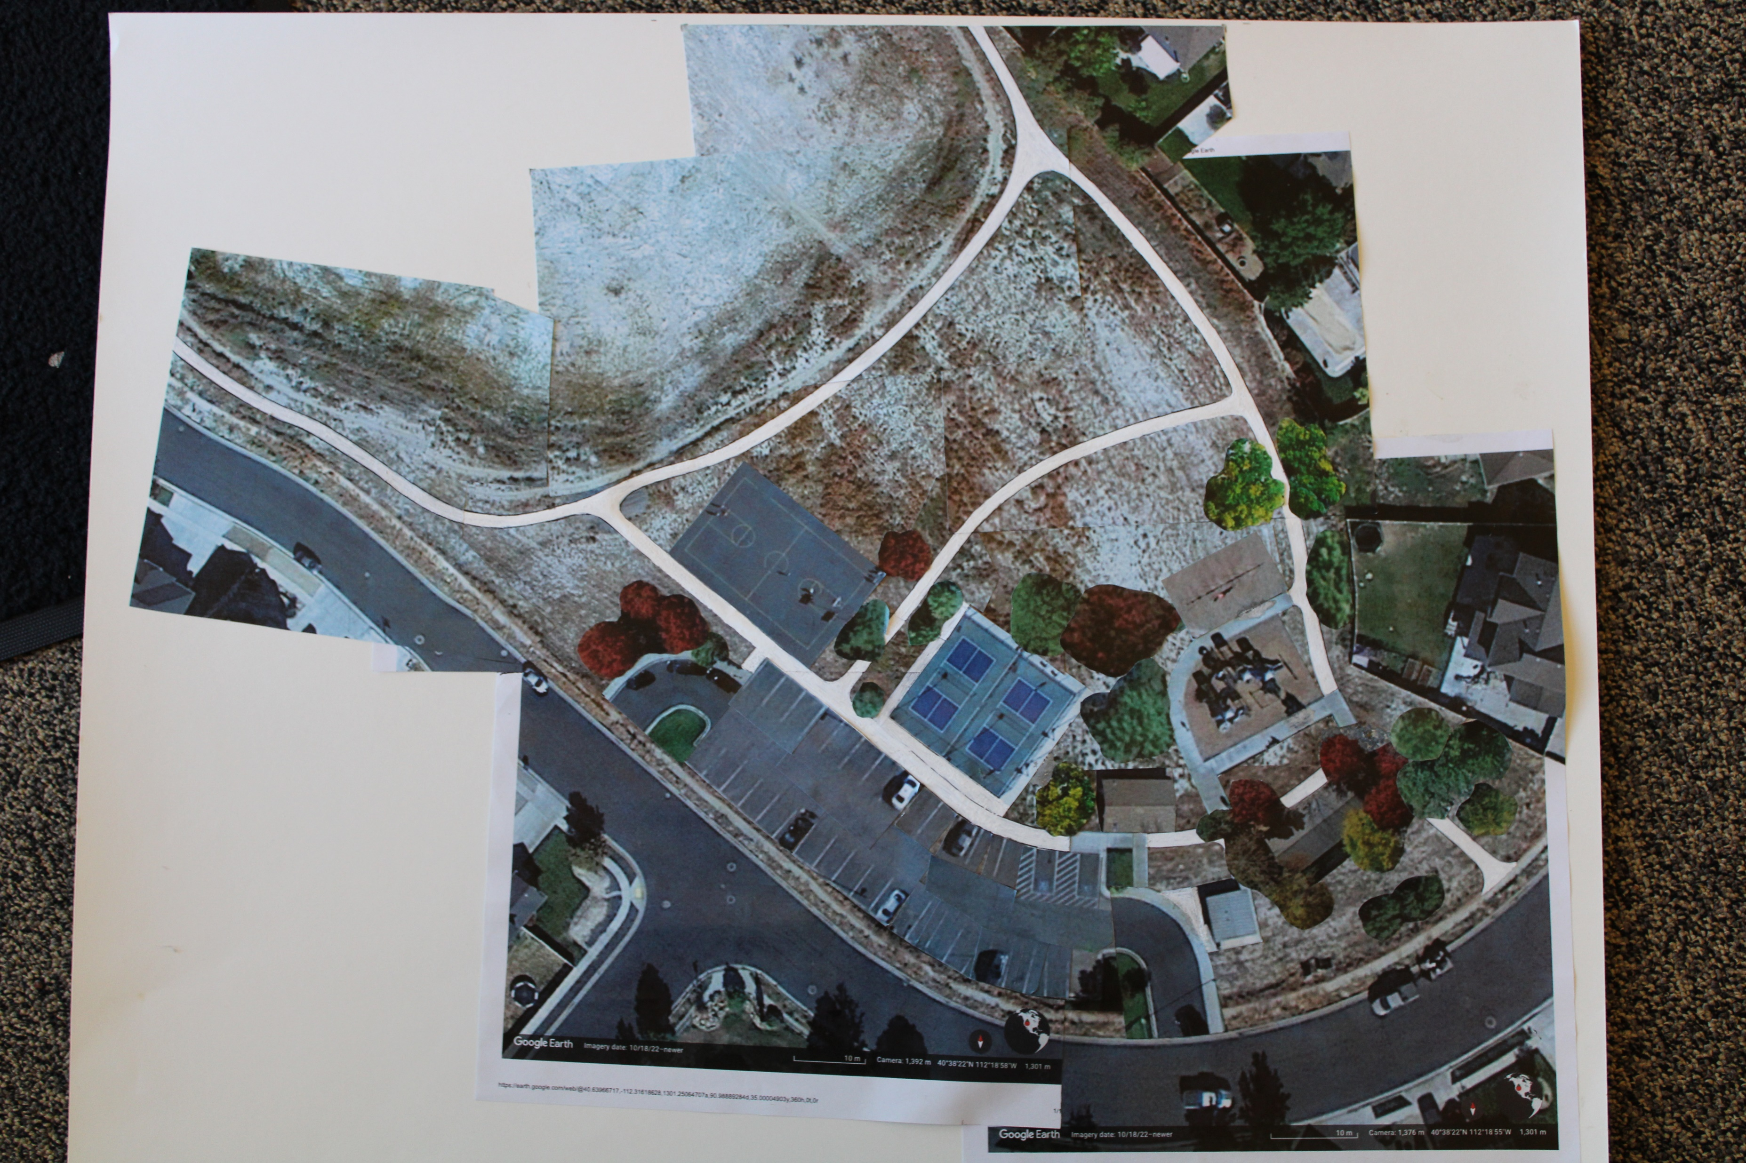

Slide 12
Fee Schedule

Slide 13
Clubhouse
Proposed Increase Fees Friday/Saturday/Sunday
 | Resident |  | Non Resident
CLUBHOUSE | Hourly (3hr minimum) | Daily | Hourly (3hr minimum) | Daily
Upstairs | $135 | $695 | $190 | $910
Downstairs | $135 | $695 | $190 | $910
Entire Building | $190 | $1,340 | $215 | $1,550
Up front deposit (damage/cleaning) | $1,500 | $1,500 | $1,500 | $1,500
***Alcohol Fee of $400 | $400 | $400 | $400 | $400
Deposit $1000/ $300 non-refundable
Proposed Increase Fees Monday-Thursday
 | Resident |  | Non Resident
CLUBHOUSE | Hourly (3hr minimum) | Daily | Hourly (3hr minimum) | Daily
Upstairs | $110 | $590 | $165 | $805
Downstairs | $110 | $590 | $165 | $805
Entire Building | $165 | $1,125 | $190 | $1,390
Up front deposit (damage/cleaning) | $1,500 | $1,500 | $1,500 | $1,500
**Alcohol Fee of $400 | $400 | $400 | $400 | $400
Deposit $1000/ $300 non-refundable

Slide 14
Pool
Current Fees
SWIMMING POOL | Resident | Non Resident
Daily Admissions | $3 | $5
Punch Card - 20 visits | $50 | $70
Season Pass - Individual | $65 | $90
Season Pass - 2 Indivduals | $115 | $165
Season Pass Family - additional per Individual | $20 | $25
Pool Party - up to 20 | $53 | $75
Pool Party - additional per individual | $3 | $4
Swim Lessons | $35 | $35
Swim Team | $90 | $90
Proposed Increase Fees
SWIMMING POOL | Resident | Non Resident
Daily Admissions | $5.00 | $10.00
Punch Card - 20 visits | $60 | $120
Season Pass - Individual | $80 | $160
Season Pass - 2 Indivduals | $130 | $260
Season Pass Family - additional per Individual | $25 | $50
Pool Party - up to 20 | $70 | $140
Pool Party - additional per individual | $5.00 | $5.00
Swim Lessons | $40 | $40
Swim Team | $100 | $100

Slide 15
GOLF COURSE | 9 Holes | Proposed increase | 18 Holes | Proposed Increase
Weekday - Adult | $14 | $15 | $23 | $25
Weekday - Junior | $5 | $8 | $10 | $11
Weekend - Adult | $19 | $21 | $28 | $30
Weekend - Junior | $5 | $11 | $10 | $15
***Cart | $8 | $10 | $14 | $15
Clubs | $10 | $11 | $15 | $16
Season Passes |  |  | Monthly payment option
Season Pass | Current Fee | Proposed Increase | per month
Adult Pass walking | $625 | $675 | $60
Spouse Pass walking | $575 | $625 | $55
Senior 65+ Pass walking | $475 | $525 | $47
Junior Pass | $300 | $350 | $32
Trail Pass * | $250 | $300 | $28
Adult Pass w/cart ** | $875 | $1,400 | $120
Senior 65+ w/cart ** | $765 | $1,200 | $104
GOLF COURSE
Punch Card
Punch Card - 20 Rounds | Current Weekday | Proposed Weekday
Weekday No Cart | $180.00 | $270
Weekday With Cart *** | $300.00 | $430
Junior no Cart |  | $150
Senior 65+ | $150.00 | $235
Senior 65+ with Cart *** | $270.00 | $385
 | Current weekend | Proposed Weekend
Weekend no cart | $220 | $375 |  | * personal cart
Weekend w/cart *** | $340 | $550 |  | ** Cart rental
Junior no cart |  | $200 |  | ***Use of a cart either owned or course provided.
Senior 65+ | $190 | $300
Senior 65+ w/cart *** | $310 | $475

Slide 16
Parks
Park Reservation Fees
 | Parks | Cost Per Hour (Resident) | Cost Per Hour (Non-Resident)
 | Gateway | $10.00 | $20.00
 | Brent Rose | $10.00 | $20.00
 | Sandhill | $15.00 | $30.00
 | Park View | $30.00 | $60.00
 | Galley Lane | $15.00 | $30.00
 | Village | $40.00 | $80.00
 | Sagers | $35.00 | $70.00
 | Porter Way Park | Only Available to reserve entire park at $1500.00 per day
 | Pickleball Courts
 | Courts | Cost Per Hour (Min 2hr Max 4hrs) (Resident) |  | Cost Per Hour (Min 2hr Max 4hrs) (Non-Resident)
 | Up to 2 Courts | 15.00 Per Hour/Per Court |  | 20.00 Per Hour/Per Court
 | Entire Pickleball Complex - 1000.00 per day
 | Tournament Fee
 | Park | Cost per Day
 | Sagers | $1,000
 | Village | $800

Slide 17
2024 Tax Rate

Slide 18
Background
Terracor/Leucadia Bankruptcy
Formation of the Service Agencies
  Designed to operate at maximum tax rate
    .0014%
  Previous boards did not keep to the requirement
    Current rate .000685
  Five fold increase in Greenbelt and Parks areas.
  20% increase in personnel and fuel since COVID
  Lack of capital to maintain the facilities
Need about $3.5 Million to maintain Facilities As Demonstrated Over the Last Year and a Half
  Currently about $2.5 Million

Slide 19
Maintenance Issues
Repair/replace damage to entry way and reseal - $2,700
Test/Restore fire suppression alarm system in clubhouse
Fire Suppression at the Pro Shop (Dry System- Install) - $5,936
Handicap/Staff Signage - $225
Paint Handicap Zone - $40
Safety Railing at Gazebo, Pool Area, Outside Stairs - $8,848-$9,680
Fix drain servicing drink machine/fire suppression system - $3,000 - $5,000
Rewire electric circuits in proshop
Add Alarms and Cameras to proshop.
Add lighting to tunnel - $15K
Fix Leakage problem in tunnel

Slide 20
Maintenance Issues (cont’d)
Repair leak in overhead windows of Clubhouse -$10,000
Replace/Repair roof gutter system of Clubhouse
Repair leak/replace siding on north wall of clubhouse
Repair roof leak over ceiling in office area of clubhouse
Utility Enclosure- $8,000-$25,000 (Depending on Design)
Pro Shop Drainage and Washing Area - $21,000
Outside bath drains - $2,000 - $3,000
Gutter and Downspouts on Clubhouse - $2,816 - $4,816
Various Stucco Repairs - $23,640
Gazebo Electrical & Lighting - $2,500-$3,500
Fix leaks in lower storage area and spa of clubhouse
Replace outside hose bib on front of building of clubhouse

Slide 21
Maintenance Issues (Cont’d)
17. Add backflow preventer to area around golf course
18. Fix sprinkler issues
  Frontage Road
  Ponderosa park
  Island greenbelts
  Causeway
Need an additional lake weed mowing boat -$90,000
Repair/replace lights along back side of clubhouse
HVAC ducting in the office area
Add/move thermostat in clubhouse
Upgrade/repair power outlets
Address Playground Equipment Safety Issues

Slide 22
Clubhouse Additional
Install new fireplace
Fix lights in upper men’s bathroom
Fix/replace stall in upper men’s bathroom
Upgrade lights in grand room
Finish lights in office area
Finish lower kitchen lighting
Redo landscaping in roundel

Slide 23
Clubhouse Additional
Redo landscape in front of clubhouse
Remove back islands in parking lot
Add Bed lighting
Add additional lighting on rear patio
Reseed grass behind clubhouse
Remove/replace vents behind fireplace
Remove dead trees/branches
Label Breaker boxes
Re-set rock on shoreline
Make an ADA compliant plan

Slide 24
Clubhouse Additional
Move ice shack
Expand/Move library
Add sprinkler to planters
Add Sprinklers to planters
Add lighting in dark areas
Add alarms and cameras
Add high amperage circuits
Electronic locks for outside doors

Slide 25
Pro Shop Additional
Modernize sales floor
Add grill to area
Add parking
Replace exterior lighting
Install new blinds
Relandscape in front of building

Slide 26
Additional at Pool
    Finish security lighting
    Add secure shower
    Fix self closing gate
    Finish concession cue area
    Add lighting behind building
    Remove unneeded equipment
    Replacement diving board
    Finish removing potential access points
    Add Cameras
    Pool needs resurfacing and deck repair
    Upgrade outside bathrooms

Slide 27
Other Area Additional
Delineation fencing around the golf course
Cameras on golf course, tunnel, parks, and clubhouse parking
No trespassing/no fishing signs on Agency open space
Remediation/landscape/upgrade of Captain’s Island green spaces

Slide 28
Major Rebuild/Replacement
Millpond Bridge
Pool
Golf Course Irrigation
Reroof the clubhouse with climate specific roofing.

Slide 29
Tax History

Slide 30
Tax Year | Tax Rate | Budget Tax Revenue | Actual Revenue
2013 | 0.0014 | $882,873.00
2014 | 0.001256 | $814,481.00
2015 | 0.001206 | $842,390.00
2016 | 0.001154 | $868,752.00
2017 | 0.00105 | $889,168.00
2018 | 0.001013 | $930,732.00
2019 | 0.001054 | $1,153,850.00 | Tax Increase approved
2020 | 0.001007 | $1,153,850.00 | $1,510,855.00
2021 | 0.000939 | $1,153,851.00 | $1,429,705.00
2022 | 0.000692 | $1,516,203.00 | $1,504,366.00
2023 | 0.000685 | $1,537,508.00 | $82,724.00
2024* |  | $1,537,508.00

Slide 31
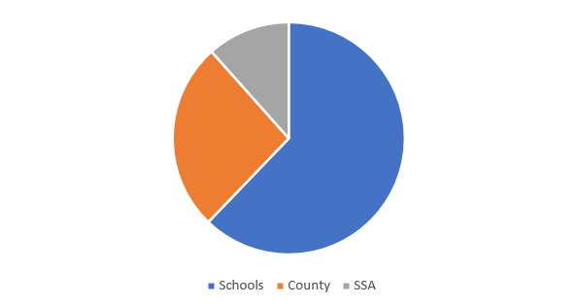
Tax Comparison

Slide 32
Tax Options

Slide 33
Tax Rate Schedule
September 27th, 2023
October 3rd, 2023
October 11th, 2023
October 18th, 2023
October 24th-27th, 2023
October 24th, 2023
October 25th, 2023
Public Meeting for Board to agree on rates
Public Notice of Increase mailed
First Newspaper Notice
Second Newspaper Notice
Open House
Truth in Taxation
Final Tax Rate approval

Slide 34
Tax Rate Comparison
Tax Rate | Increase in Tax Revenue per District | Tax Revenue | Tax Increase on $186,000 Median Home/per District
.000682(Current) | $0.00 | $1,537,508.00 | $0.00
.00128 (2022-23) Level | $625,000 | $2,337,209.00 | $61.37
.0014 (Max Tax Rate) | $745,000 | $3,017,508.00 | $73.15

Slide 35
Services Shortfall

Slide 36
 | EQUIPMENT
 | 2023 due/ previously ordered | 2023 Requested/ not in budget
Golf Course | 2 Triplex Mowers | 2 Triplex Mowers
 | Greens Sprayer | 2 Utility Carts
 | Large Sprayer | Large Rough Mower
 | 2 Vertical Reel Sets | Bunker Rake
 |  | Trim Mower
 |  | Core Harvester
Parks and Recreation |  | Pickup
 |  | 2 Utility Carts
 |  | 2 New Mowers

Slide 37
 | Personnel
 | Allotted | Needed
Golf course | Greens Keeper | Greens Keeper
 |  | Mechanic
 | Irrigation Tech | Irrigation Tech
 |  | Asst. Irrigation Tech
 | Full Time Laborer -3 | Full time Laborer - 1
 | Seasonal/Part Time - 2 | Seasonal/Part Time -5
Pro Shop | Pro/Manager - 1 | Pro Manager -1
 | Asst. Pro. - 0 | Asst. Pro -1
 | Staff - 2 | Staff -2
 | Cart Wrangler -15 | Cart Wrangler - 7
Park and Rec | Manager - 1 | Manager -
 |  | Mechanic
 | Irrigation Tech - 1 | Irrigation Tech - 1
 |  | Mechanic -1
 |  | Asst. Mech -1
 |  | Build. Maint - 1
 | Asst. Irr Tech -1* | Asst Irr Tech -1
 |  | Gardner -1
 | Full Time Laborer - 4 | Full Time Laborer - 2
 | Part Time/Seasonal -5 | Full Time Seasonal -13
Admin | GM** - 1 | GM -1
 | Business Mgr - 1 | Business Mgr - 1
 | Project Manager -1 | Project Manager -1
 | Executive Sec - 1/2 | Executive Secretary -1
 | Admin Clerk -1 | Admin Clerk 1 1/2

Slide 38
Discussion
At the .000682 rate there will be no money for: continued improvement to golf course, increased personnel in the operations side to service parks and greenbelts (means we will have to let some go), purchase of second boat for lake, funding library personnel, fixing safety and maintenance issues, building contingency for emergencies, in house facilities upgrades and new construction of parks or other areas.
At the .00128 level we can sustain at the same level as we did during the 18 month period Jan 2022 – May 2023. Some equipment shortfalls, can fix some safety and maintenance issues, limited ability to attack all the needed maintenance issues.
At the .0014 level we can begin to build back neglected and damaged infrastructure, can start to develop plans for expanded services.

Slide 39
Board Member Reports and Concerns

Slide 40
Adjourn

Slide 41
Closed Session

Slide 42
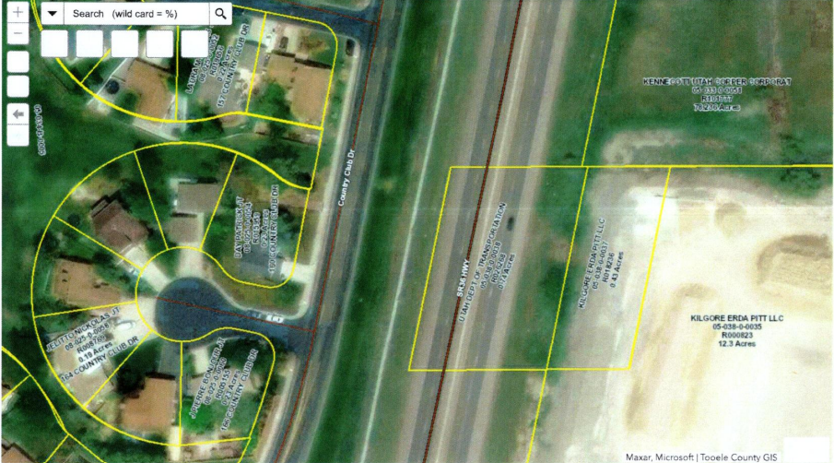
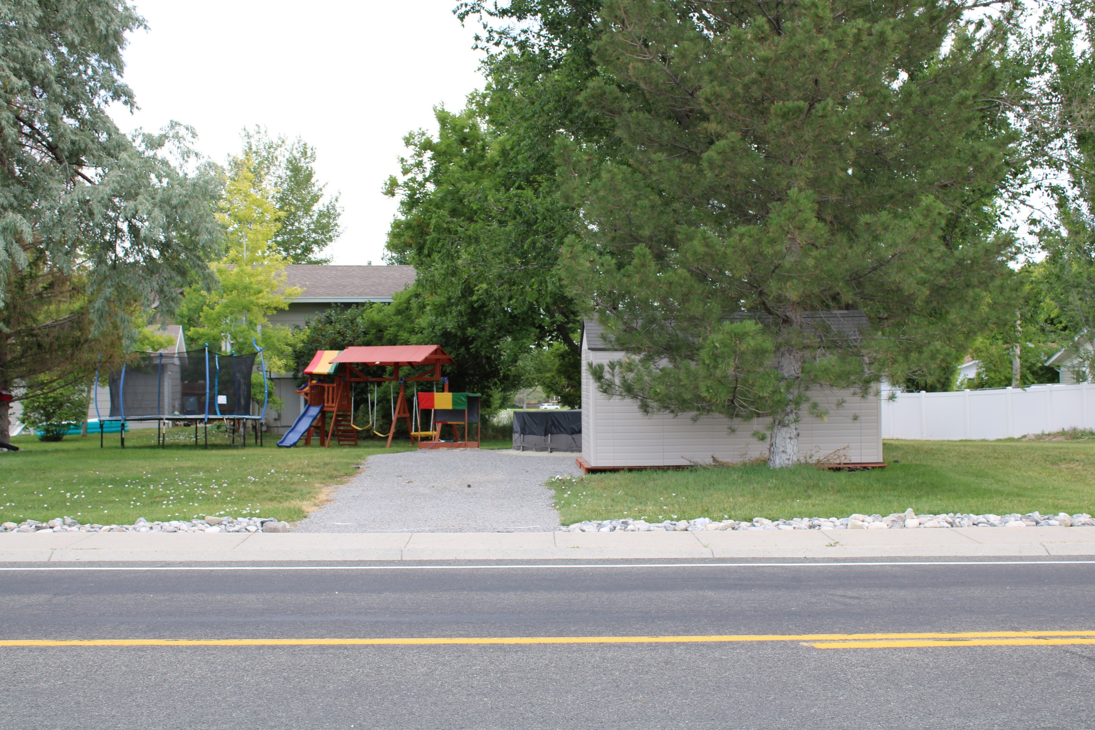
Encroachment on 160 Country Club

Slide 43
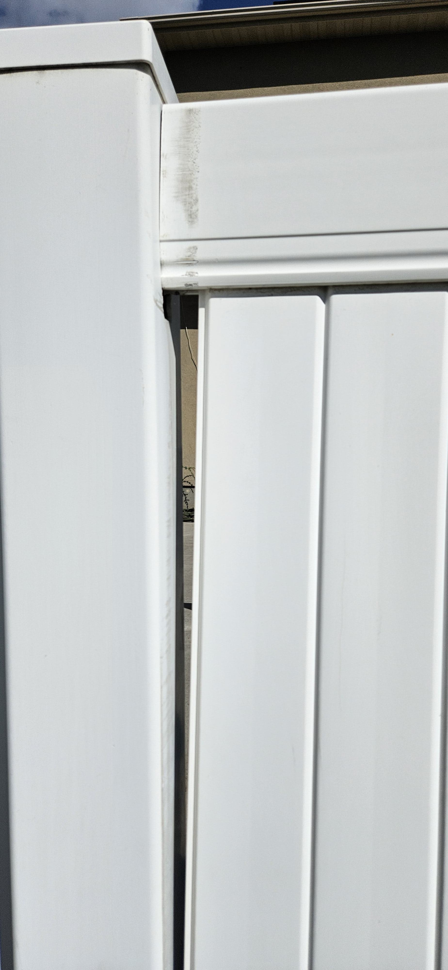
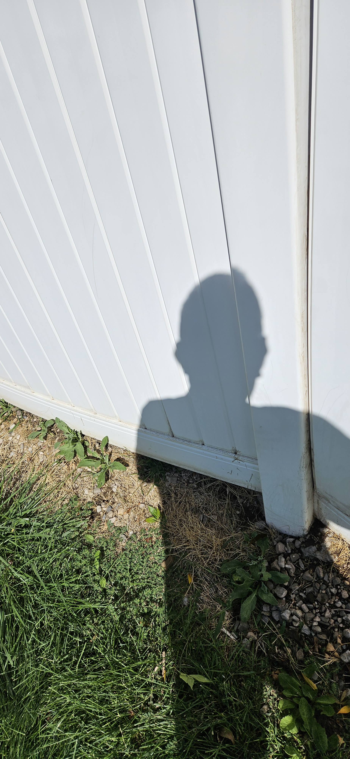
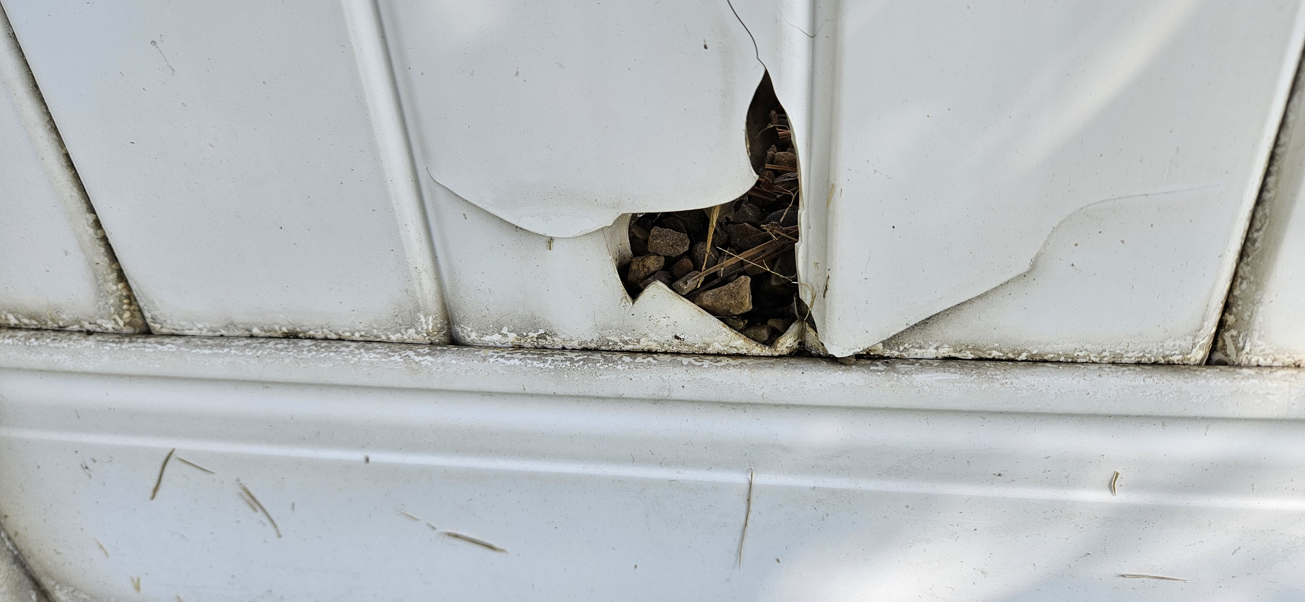
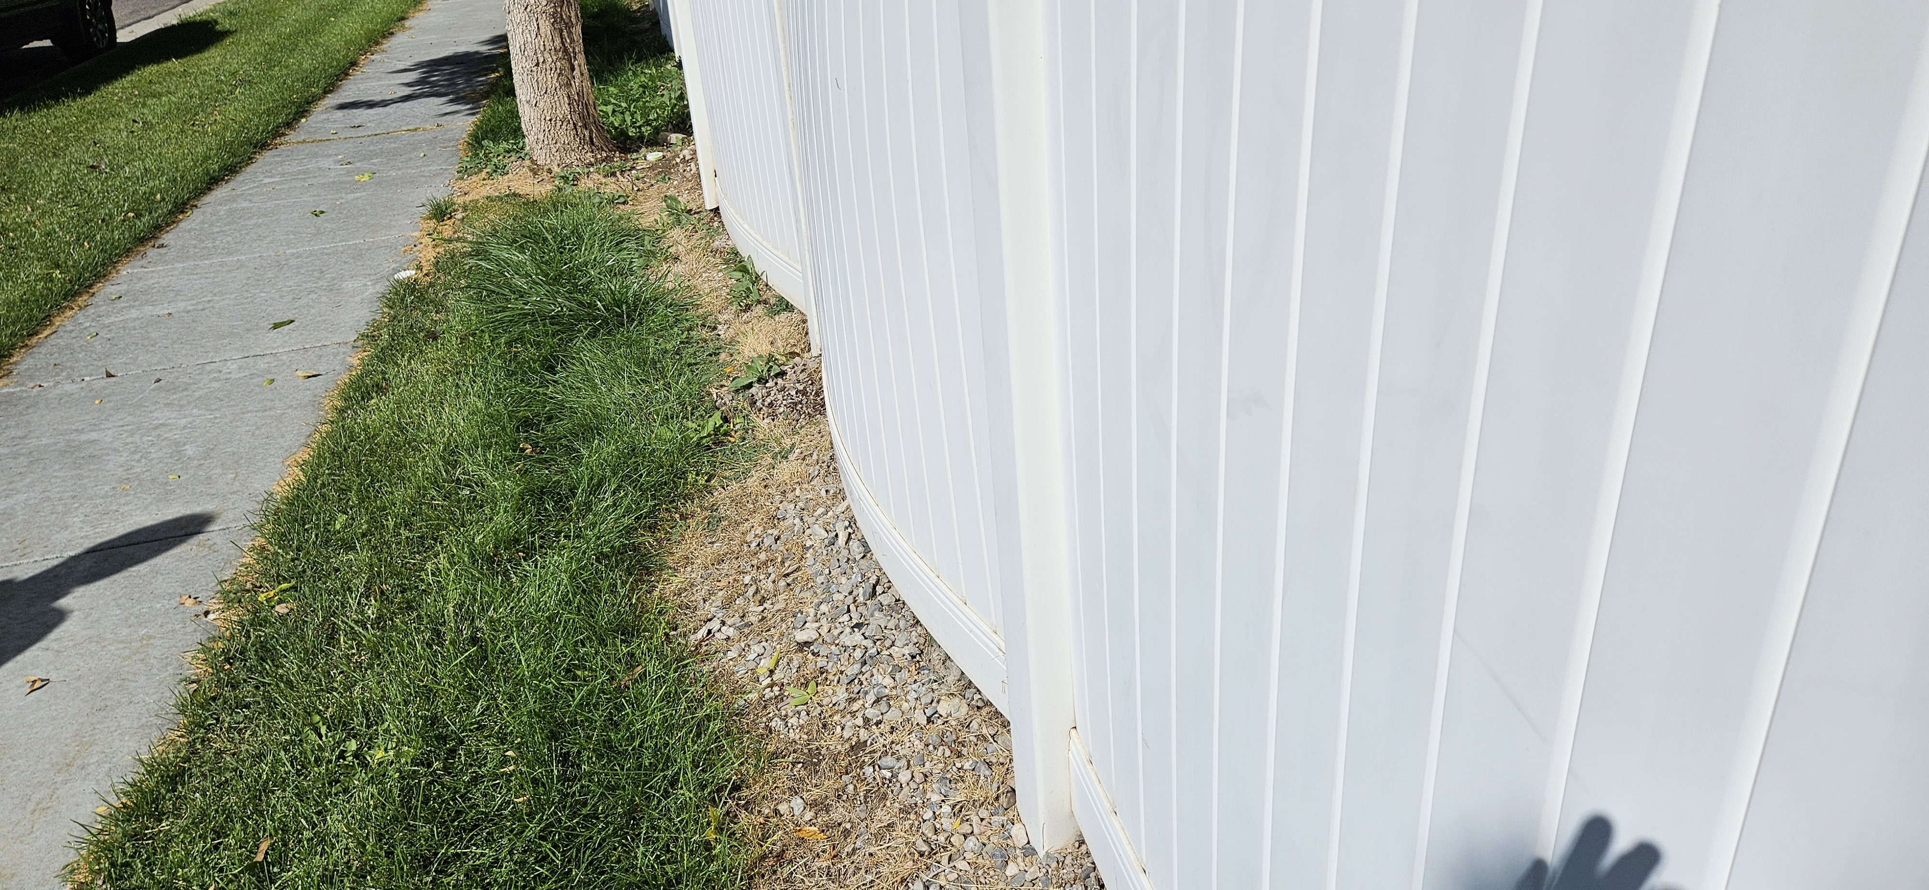
33 West Nautical Slide

