Slide 1
Stansbury Service Agency Board Business Meeting
June 28, 2023

Slide 2
Agenda
Order of Business
Call to Order
Roll Call
Pledge of Allegiance
Sheriff Report
Fire Chief Report
Open Forum for Public
Staff Updates and Reports
Budget Report and Updates
Action Items
Board review and possible approval of April 26, 2023, Business meeting minutes
Board review and possible approval of May 10, 2023, Work meeting Minutes
Board review and possible approval of May 18 2023, Special meeting minutes
Solomon Park Final Phase
Shoreline and Fishing Improvement
Pool Renovation
SPID Easement
Fee Schedule for Pool and Golf Course
Board Member Reports and Discussion Items
Board Member Reports and Concerns
Adjourn
Closed Session to discuss personnel, pending or threatened litigation, or property acquisition (as needed)

Slide 3
Open forum for the public

Slide 4
Financial update

Slide 5
Financials Update
Bank Accounts Balance as of 6/28/2023:
Personnel Costs:
Golf Course Revenue:

Slide 6
Report on Audits
State Financial Audit:
The audit was completed a week ago and has been submitted to the State.
Worker’s Comp Audit:
The audit was completed a week ago.
State Treasurer Unclaimed Property Division Audit:
The audit is due on July 12th

Slide 7
Capital projects update
Clubhouse
Fireplace
Doors
Outside Deck
Soundwall Trail
Porter Way Bathroom

Slide 8
Solomon Park

Slide 9
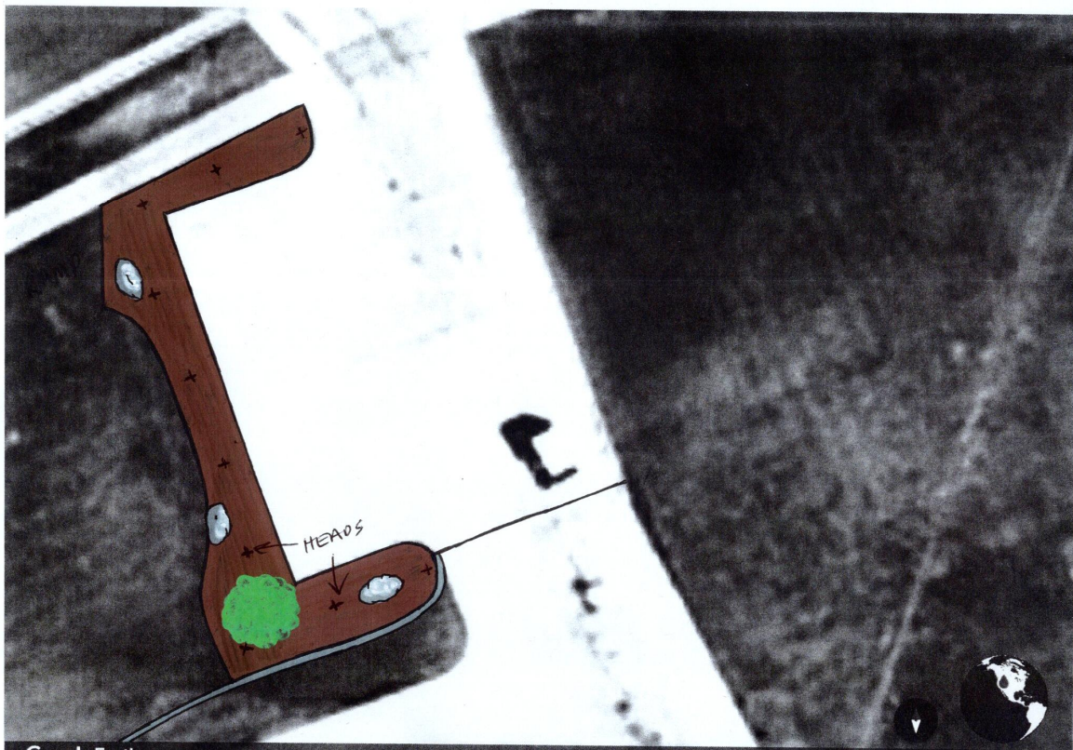
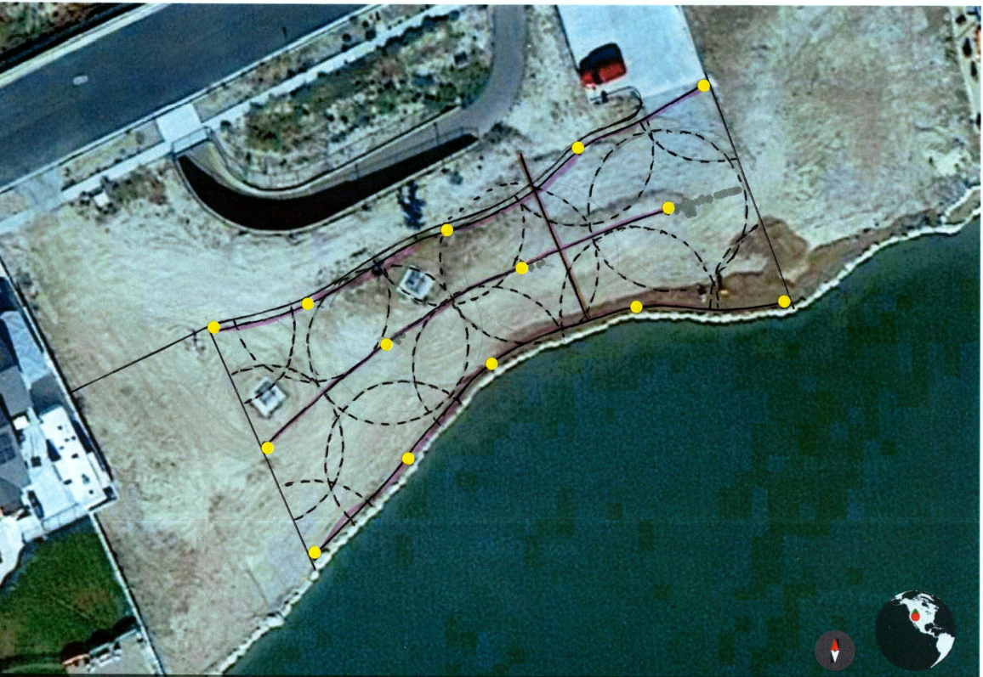
SOLOMON PARK IMPROVEMENT DRAWINGS

Slide 10
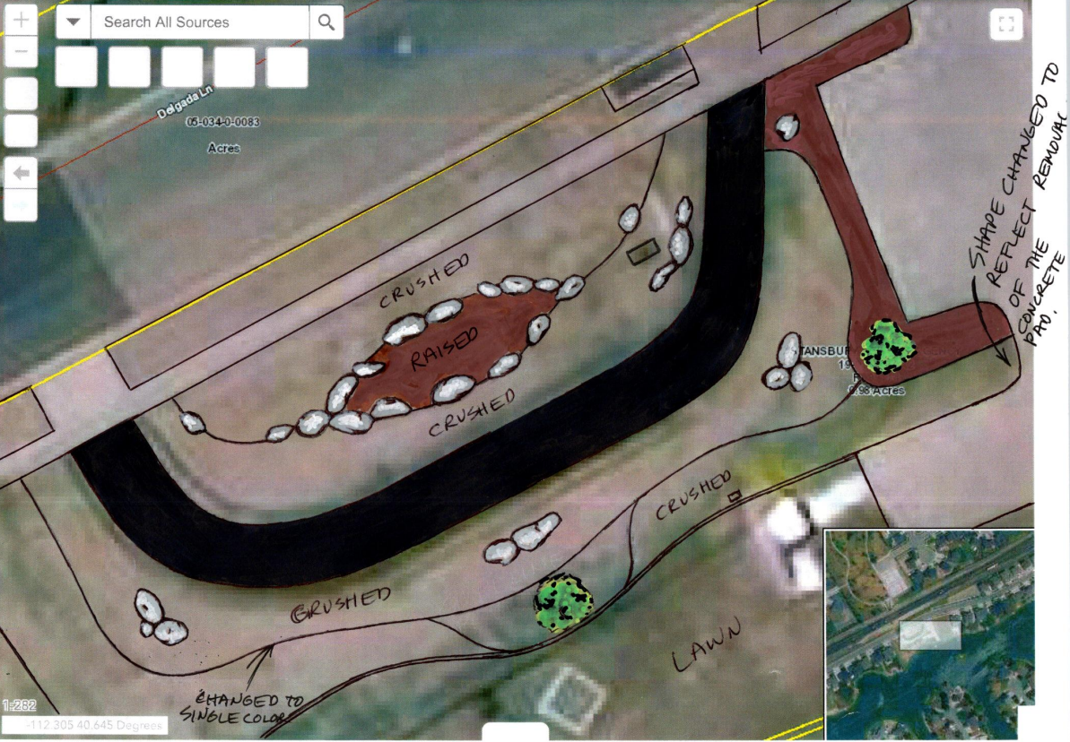
SOLOMON pARK iMPROVEMENT dRAWINGS cONTINUED

Slide 11
Cost estimate
Contractor | Bid
Mettler | $86,550.00
Powell Landscape | $76,500.00
USA Building System | $37,285.00

Slide 12
SHORELINE IMPROVEMENT

Slide 13
ESTIMATES FOR RAFTS AND DOCKS
PATRIOT DOCKS (PRICES ARE APPROXIMATE AND FOR MATERIALS ONLY)
16’x16’ attached swim platform with 24’ ramp- $15,876.99
16’x16’ swim raft- $10,216
50’ fishing / mooring dock- $7,958.99
All of the most popular dock companies are located at or near the east coast and don’t ship directly to our area. Patriot Docks provides a competitive product and sells piecemeal through a number of distributors such as Home Depot, Walmart, Northern Tool, etc.. None provide “packages” for rafts or docks through these distributors. The pricing reflects the lower pricing from the distributors for the necessary parts. Final pricing will vary. I have found NO local contractors specializing in dock installation to get bids from. Still trying.

Slide 14
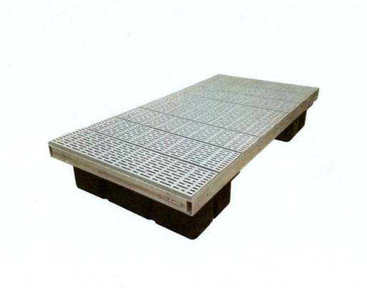
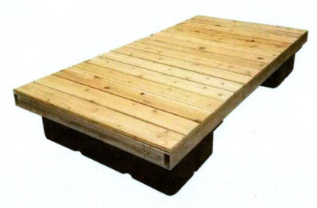
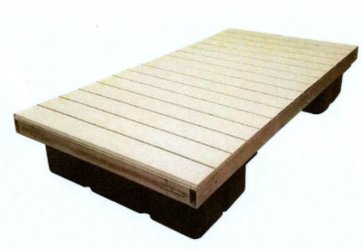
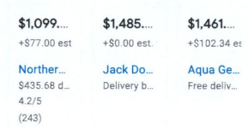
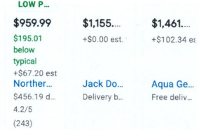
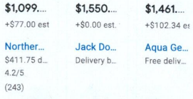
Aluminum
(2 Color Options)
Poly Decking
Wood

Slide 15
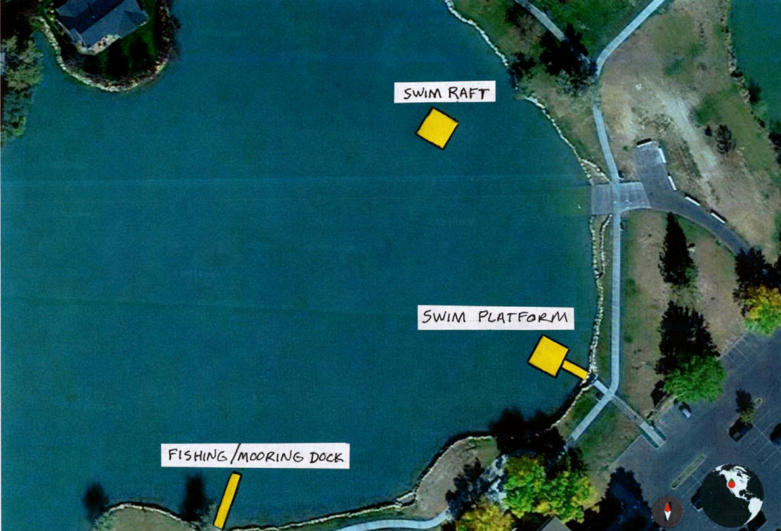
Location for Docks

Slide 16
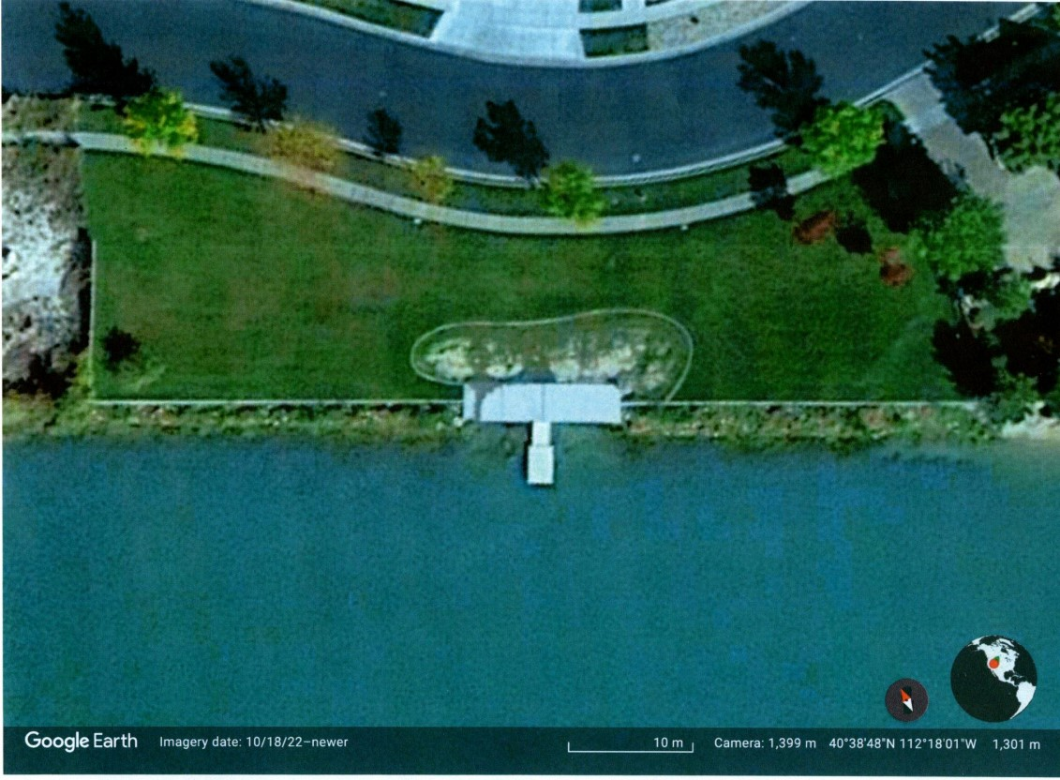
Delgada Shoreline

Slide 18
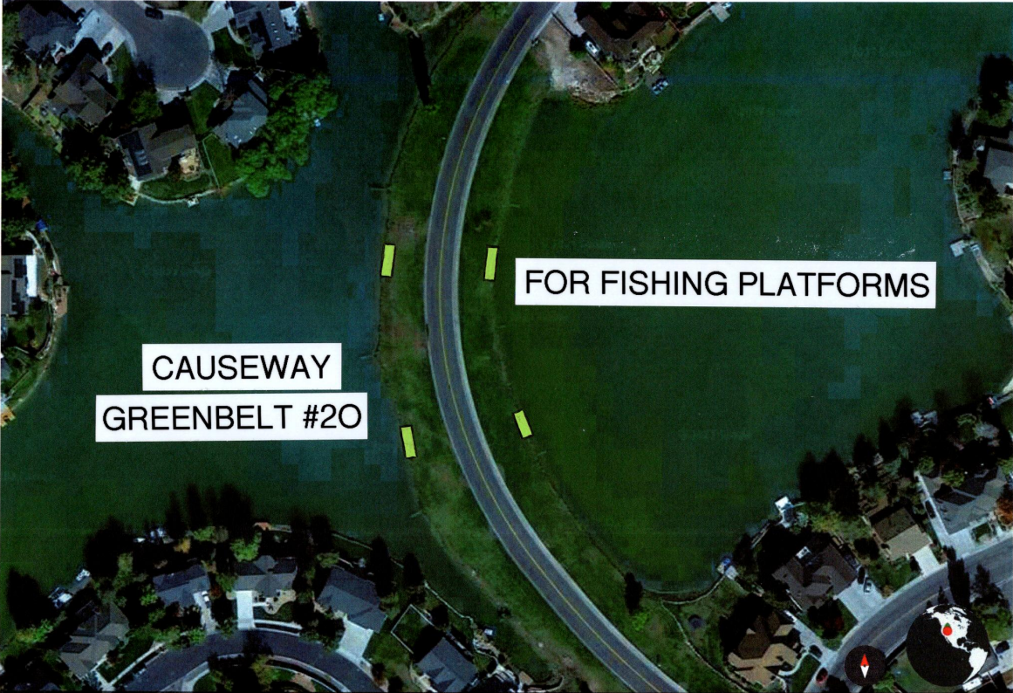
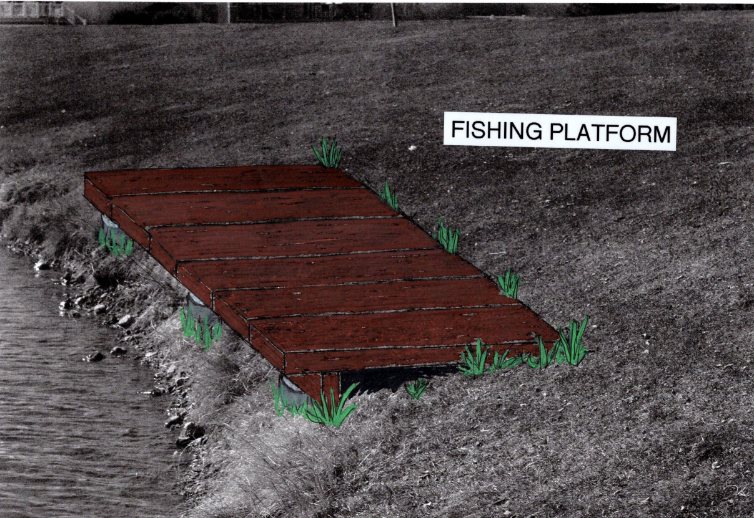
FISHING platforms

Slide 19
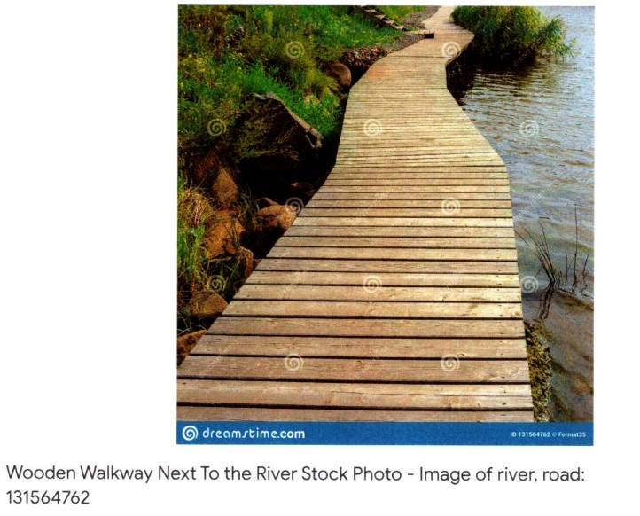
CAUSEWAY BOARDWALK

Slide 20
Cost Estimate and Funding FOR SHORELINE IMPROVEMENT
Estimate and Funding is still pending on final design

Slide 21
Pool reclamation

Slide 22
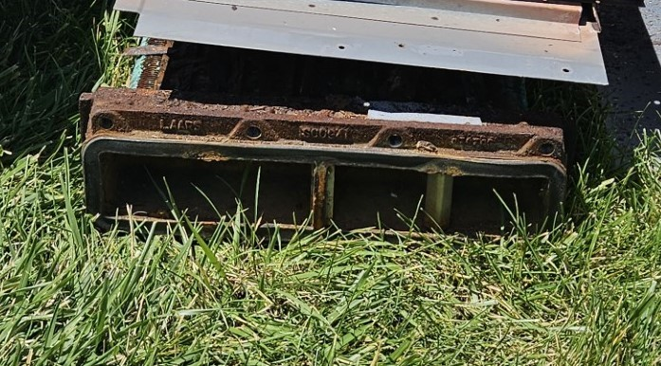
BOILER

Slide 23
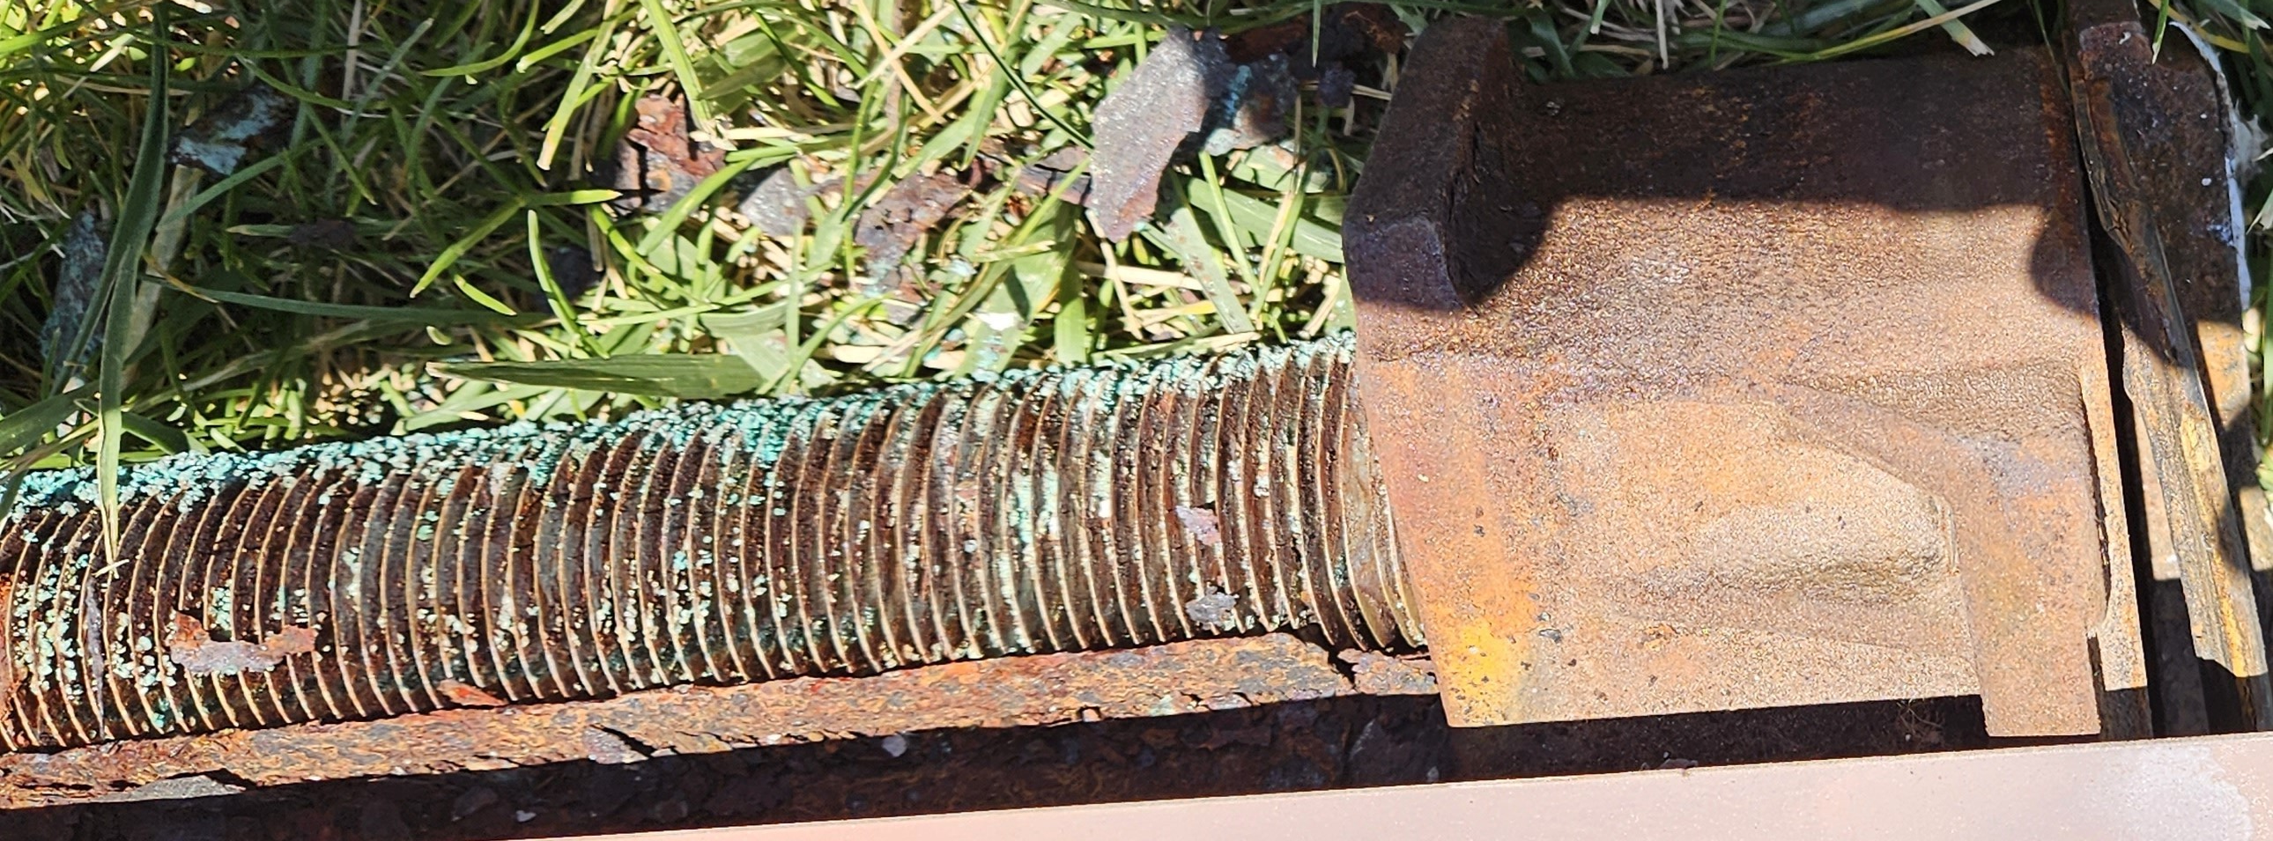
Exterior of the Boiler

Slide 24
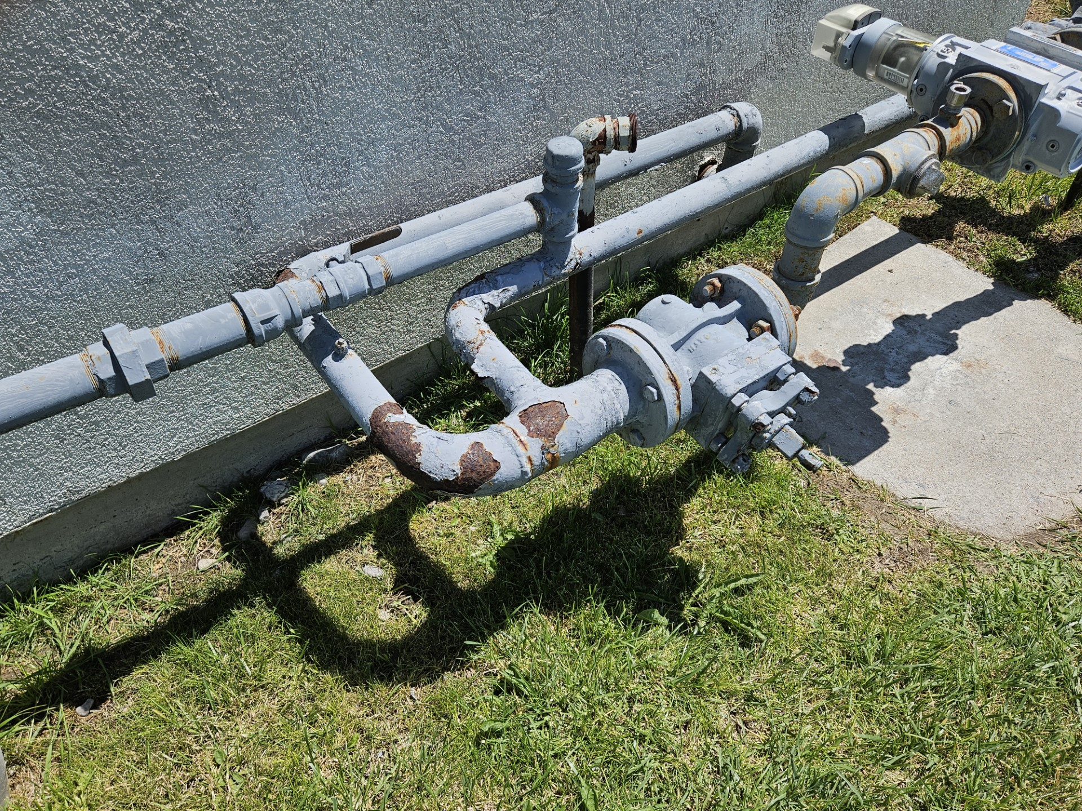
GAS FEED LINE

Slide 25
Tasks and cost
Remove old Boiler – In house John/Brady (2 Days)
Aquatech Cost to Remove - $1400.00
Build base for Boilers (2 Days
Purchase preformed concrete pads
Pour new cement pad - $200.00
Aquatech adds struts - $400.00-$500.00
Install new Boilers (12-13 July)
Cost of 4 small boilers - $22,690.00
Ancillary Materials (piping, connectors, etc) - $4,000.00
Labor - $3580.00
Diving Board
Cost- $6,014.00
Structural Analysis – Still undetermined

Slide 26
Spid easement

Slide 27
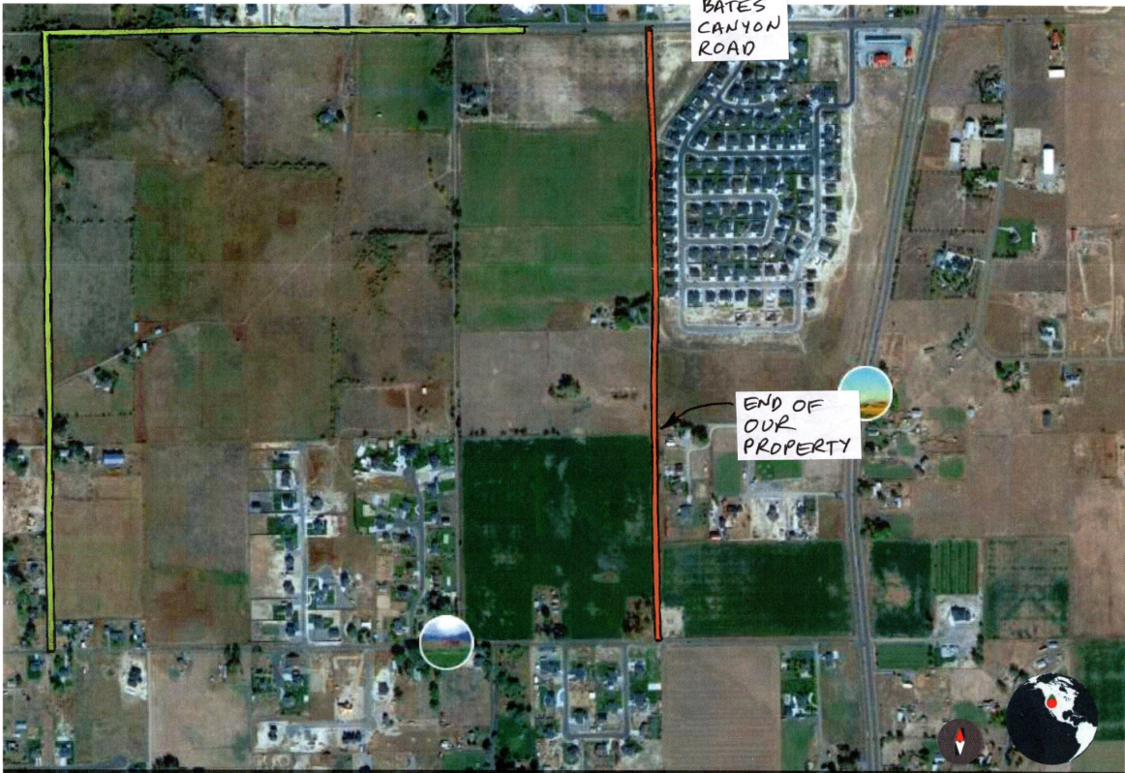
SPID EASEMENT Drawing

Slide 28
Fee Schedule
FOR THE
Pool & Golf Course

Slide 29
Board member comments or concerns

