Slide 1
Stansbury service agency business meeting
August 23, 2023

Slide 2
Agenda
Order of Business
Call to Order
Roll Call
Pledge of Allegiance
Sheriff Report
Fire Chief Report
Open Forum for Public
Staff Updates and Reports
General Manager Update
Action Items
2023.08.01 A
Board review and possible approval of June 14, 2023 Work Meeting Minutes
2023.08.02 A
Board review and possible approval of July 12, 2023 Work Meeting Minutes
2023.08.03 A
Board review and possible approval of July 26, 2023 Business Meeting Minutes
2023.08.04 A
Board Discussion on Conference Room Rate
Public Comment on Conference Room Rate
Board review and possible approval of Conference Room Rate
2023.08.05 Presentation of “A Light to Remember”
Board Member Reports and Discussion Items
Board Member Reports and Concerns
Adjourn
Closed Session to discuss personnel, pending or threatened litigation, or property acquisition (as needed)

Slide 3
General Manager Updates

Slide 4
2023 Capital Projects
Clubhouse Remodel – 99% Complete
Pool
Closing after Labor Day Weekend
Pool Structural Analysis 6 Sept- $4K
Golf Course Upgrades
Green Resodding Complete
Planning to have new greens open by Labor Day Weekend
Rewiring of last four holes done inhouse
Started on hole 10
Water Infrastructure
Looking to have joint meeting with SPID to go over the water system
Hole 3/Gordon Well Actions
Root Removal and Pipe Video – $5.2K
Weir rebuild repair
Gordon Well Equipment Repair

Slide 5
Impact fee Projects
Solomon Park
Phase I – 30% Complete
Phase II – Loading Zone
Out for Bid
Millpond Park (Amphitheater)
Design Pending Information on Lighting
Porter Way Bathroom
Pending Final Site Location from Planning Committee
Soundwall Trail
80% UDOT/20% Agency
Pending UDOT Information on Right of Way
Bathroom Delivery Issue
Bathroom Delivery Schedule
Adding $26K Change Order to Extend Parking Area

Slide 6
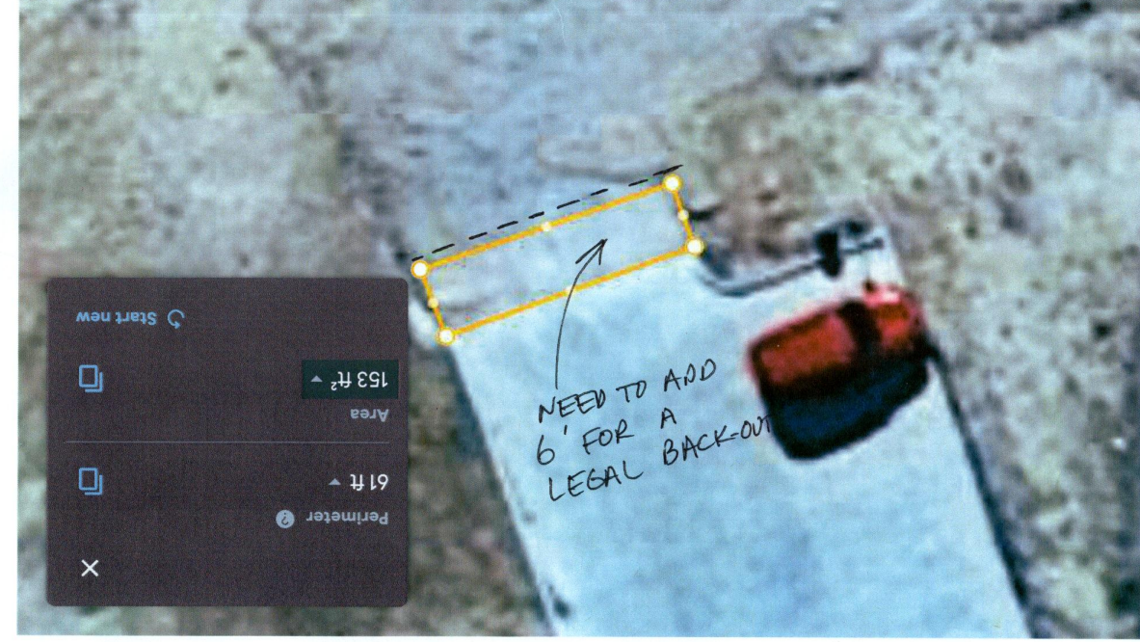
Once the seam was popped, it didn’t leave enough room for a proper back-out for the last vehicle (as per the red vehicle shown). There was concern about the lack of a barrier to keep vehicles off the new grass. If we a 6’ slab with weeps and curbing is added, it would take care of both a back-out and a barrier to vehicles. A three-foot-wide gap could also be installed at the east end to accommodate wheelchair access to the lawn. This item can be added to the loading zone bid-out.

Slide 7
Bathroom and Handicap Ramp Location at Amphitheatre

Slide 8
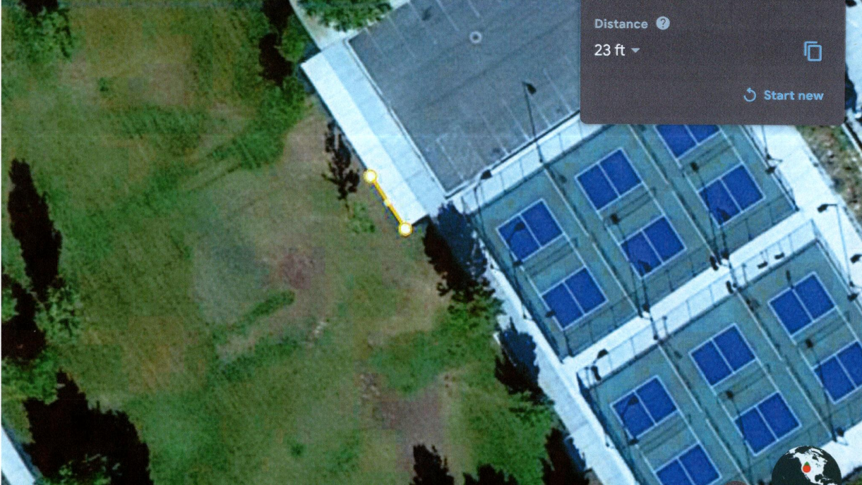
Location of Bathroom at Porter Way Park

Slide 9
Impact Fees Projects (Cont’d)
Shoreline Improvements
Combination of Grants and Internal Match
$116K Grant 60/40 Match with DWR
$16 K Tooele Co. Grant (can be used to offset DWR Match Requirement)
Split Into 2 Phases
Phase I Swimming platforms, Fishing Dock in Clubhouse Area and Delgada Park Shoreline
Dock Swimming Platform Has Been Delivered
Phase II Clubhouse Shoreline Work to Support Swimming Area

Slide 10
Stansbury Days/Tunnel Project
Stansbury Days Was a Success
Final Costs Will Be Presented at the Work Meeting
Parking and Congestion in Clubhouse Area an Issue
First Legal Stansbury Days Ever
Tunnel Vision
90% Complete
Need To Add Link
Seal Tunnel
Final Costs Presented Next Week

Slide 11
FINANCIALS
Bank accounts Balance
as of 7/31/2023
BANK | GENERAL | IMPACT FEES
Zion's | $ 85,502.88 | $ 202,871.81
Chartway | $ 1,087.11
PTIF | $ 503,645.17 | $ 1,103,580.54
Total | $ 590,235.16 | $ 1,306,452.35
Pool Revenue
April | $ 6,586.00
May | $ 10,900.00
June | $ (10,646.25)
July | $ 14,145.25
Total | $ 20,985.00
Golf Course Revenue
Jan | $ 3,815.50
Feb | $ 6,750.22
Mar | $ 22,058.62
Apr | $ 94,875.64
May | $ 76,102.70
June | $ 82,946.19
July | $ 78,512.19
Total | $ 365,061.06
Capital Expense
Clubhouse Improvement | $ 124,734.00
Golf Course Improvement | $ 123,078.00
Golf Course Equipment | $ 57,695.00
Pro Shop Improvement | $ 38,519.00
ProShop Equipment | $ 42,145.00
Swimming Pool Improvement | $ 18,142.00
Swimming Pool Equipment | $ 3,057.00
Park Equipment | $ 84,134.00
Park Improvement | $ 6,543.00
Total | $ 498,047.00
Employee Payroll
Jan | $ 107,321.41
Feb | $ 79,046.98
Mar | $ 75,505.74
Apr | $ 163,925.59
May | $ 147,842.22
June | $ 126,694.28
July | $ 144,461.55
Total | $ 844,797.77

Slide 12
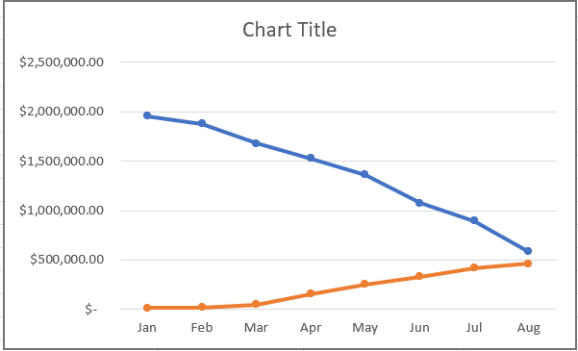

Slide 13
Management Meetings
Coordination with County
Met with Jared Hamner and Andy Welch (County Manager)
Key issues:
Library
Support for Lake Enforcement
Coordination with County Entities
Understood Budget Issues and Shortfall
Lake Discussion with Brent Rose (Initiated By Trent Ladle Survey)
Lake Has Always Been Public
If Lake Were Restricted, How Do You Enforce It?

Slide 14
BOARD OPERATION PROCESS
Capital Projects Committee
James Hanzelka
John Wright
Randall Hinton
Brett Palmer
Project Design Parameters
Policy Committee
Cassandra Arnell
James Hanzelka
John Wright
Policy, Manual Config Control
Finance Committee
Ammon Jacobsmeyer
Maria Sweeten
Budgeting
Fiscal Control
Board Work Meeting
Board Review and Comment
Board Business Meeting
Public Comment, Final Approval

Slide 16
Approval of Minutes

Slide 17
Conference room rates

Slide 18
Proposed Conference Room Rates
Proposed Conference Room Rates
Rental Option | Duration | Price
Hourly Rate | Per hour | $30
Half Day Rental | 4 hours | $110
Full Day Rental | 8 hours | $220
Day/Night | 8am-10pm | $375
Conference Room Comparison Rates 2023
Location | Capacity | Rate
The Station in Tooele | 30 | $70/3hr
Frontrunner Boulevard Executive Center | 14 | $40.00/hr
Sandy Center | 10 | $49.00/hr
South Jordan Executive Center | 20 | $60.00/hr
Broadway Media | 30 | $75/hr
700 East Conference Center | 24 | $106.25/hr

Slide 19
A Light to Remember Presented by Matt Huntington

Slide 20
Board Members Reports and Concerns

Slide 21
Meeting Adjourned

Slide 22
Closed session to discuss personnel, pending or threatened litigation, or property acquisition (as needed)

