Slide 1
Stansbury Service Agency Business Meeting
July 26th, 2023

Slide 2
Agenda
Order of Business
Call to Order
Roll Call
Pledge of Allegiance
Sheriff Report
Fire Chief Report
Open Forum for Public
Staff Updates and Reports
General Manager Update
Action Items
2023.07.01 A
  Board review and possible approval of May 18, 2023 Special Meeting Minutes
2023.07.02 A
  Board review and possible approval of May 24, 2023 Business Meeting Minutes
2023.07.03 A
  Board review and possible approval of June 14, 2023 Work Meeting Minutes
2023.07.04 A
  Board review and possible approval of June 26th, 2023 Business Meeting Minutes
2023.07.05 A
  Board review and possible approval for Updated Policy Committee Charter
2023.07.06 A
  Board Discussion on Solomon Park Loading Area
  Public Comment on Solomon Park Loading Area
  Board review and possible approval of Solomon Park Loading Area
2023.07.07 A
  Board Discussion on Stansbury Days Support
  Public Comment on Stansbury Days Support
  Board review and possible approval of Stansbury Days Support
2023.07.08 A
  Board Discussion on Amended 2023 Budget
  Public Comment on Amended 2023 Budget
  Board review and possible approval for Amended 2023 Budget
Board Member Reports and Discussion Items
Board Member Reports and Concerns
Adjourn
Closed Session to discuss personnel, pending or threatened litigation, or property acquisition (as needed)

Slide 3
General Manager Updates

Slide 4
Project Updates
Solomon Park
  Contractor started grading
  Approval to bid boat area
Porter Way Park Bathroom
  Sewer/Water Identified
  SPID working with template for final connection
  Project Planning Group to deliver connection electrical plan
Shoreline Improvement
  Dock with swim platform ordered, waiting for final pricing on swim platform/fishing dock
  Estimates for shoreline rock for Delgada Fishing Area

Slide 5
Project Updates Continued
Soundwall Trail
  Letter sent to the owner of the land strip
  If no response by August 1st, 2023, we will proceed with the final architectural design and bid
Millpond Park
  Bids for parking lot
  Build Second Bathroom
  SPID to make the connection
Clubhouse Remodel
  Sound/AV installation completed
  Bathroom painting and wall closure will be done next week
Golf Course Upgrade
  Starting on hole 10

Slide 6
Pool Revenue
Bank Accounts
Golf Course Revenue
Jan | $ 4,982.50
Feb | $ 5,310.25
Mar | $ 22,080.87
Apr | $ 94,875.44
May | $ 77,634.66
June | $ 83,099.79
July | $ 65,830.25
Total | $ 353,813.76
Employee Payroll
Capital Project Expenditure
Jan | $ 107,321.41
Feb | $ 79,046.98
Mar | $ 75,505.74
Apr | $ 163,925.59
May | $ 147,842.22
June | $ 126,694.28
July | $ 65,463.14
Total | $ 765,799.36
Clubhouse Improvement | $ 124,208.00
Golf Course Improvement | $ 123,078.00
Golf Course Equipment | $ 57,695.00
Pro Shop Improvement | $ 38,519.00
ProShop Equipment | $ 42,145.00
Swimming Pool Improvement | $ 18,142.00
Swimming Pool Equipment | $ 3,057.00

Slide 7
Solomon Park Loading Area

Slide 8
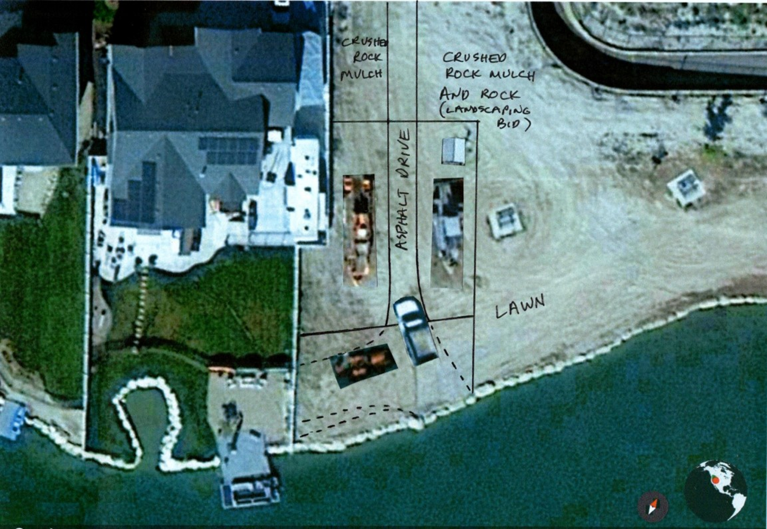

Slide 9
Stansbury Days Support

Slide 11
Budget

Slide 12
Tax Cycle
Year 0
October – Approve Year 1 Budget
November – Approve tax increase for Year 2
Year 1
January – December – Executive Yearly Budget
December – Receive Year 1 tax money
Year 2
January – December – Execute Year 2 Budget
December – Receive Year 2 Money with Tax Increase

Slide 13
Color of Money
Impact Fees
Capital Projects
Operating Budge

Slide 14
Amended 2023 Budget
$800,000.00 over budget
  Over Estimated
    Taxes
    Revenue
  Additional Cost
    Pool
Expended most of Management Reserve
Working on Updated Budget
Get Well Plan
  Cancelled purchases
  Look at all costs
Need to take a more realistic approach to 2024 budget

Slide 15
BOARD MEMBER REPORTS AND CONCERNS

