Slide 1
Stansbury Service Agency Work Meeting
Wednesday, 9 August 2023

Slide 2
  The agenda items for this meeting are as follows:
  Call to Order
  Roll Call
  Pledge of Allegiance
  Review of Public Comments
  General Manager Updates
  Discussion Items
  Review of Maplewood Annexation Revision
  Rental Rates for Clubhouse Conference Room
  Vandalism Actions
  90 Day Agency Assessment Out brief
  Presentation
  Public Question and Answers
  Board member reports and requests
  Adjournment
  Closed Session as needed to discuss personnel, pending, or threatened litigation, or property acquisitions.

Slide 3





Review of Public Comments

Slide 4
Public Comments from Meeting on July 26, 2023
Possibility of helping bring lake weed to shoreline from lake for elderly who cannot do it.
Tamarisk tree needing to be removed that is located by Gazebo
Vandalism by the transient fishing population.
Issues with the lake being public and how to make lake private
Greenspace concerns with individuals urinating and vandalizing.
Grass clippings being left behind on the shoreline
Enforcing gas boats on the lake not being allowed.
Children causing issues after 11pm on lake front owner property. Sheriff told them to contact Parks and Rec
Library
  More volunteers
  Advertising
  Board members being involved with the Library Board

Slide 5
General Manager Updates
2023 Capital Projects
Clubhouse Remodel – 99% Complete
Pool Boiler Replacement – Up and Operational
  Potential Need to Rewire Boiler Electricity
Golf Course Upgrades
  Green Resodding Complete
  Rewiring of last four holes done inhouse
Assessments Needed in 2023
  Pool Structural Analysis - $4K
  Hole 3 Root Removal and Video – $5.2K *
    Deferred

Slide 6

Impact Fee Projects
Solomon Park
  Landscaping in Progress
  Loading Zone - Ready for Bid
Millpond Park (Amphitheater)
  Parking Lot and Bathroom
  Project Planning Committee working on updated Plan
Porter way Bathroom
  Project Planning Committee working on final siting
Soundwall Trail
  80% Grant/20% Impact
  In Final Planning Phase

Slide 7
Impact Fee Projects (Cont’d)
Shoreline Improvements
  Combination of Grants and Internal Match
    $116K Grant 60/40 Match with DWR
    $16 K Tooele Co. Grant (can be used to offset DWR Match Requirement)
    Split Into 2 Phases
      Phase I Swimming platforms, Fishing Dock in Clubhouse Area and Delgada Park Shoreline
      Phase II Clubhouse Shoreline Work to Support Swimming Area

Slide 8
Discussion Items

Slide 9
Review of Maplewood Annexation Revision

Slide 10
MAPLEWOOD ANNEXATION
Previously Approved by Board
Paperwork Lost at County
Individual Lots Annexed into Agency
Revised Paperwork Requires Second Approval

Slide 11
Rental Rates for Clubhouse Conference Room

Slide 12
Proposed Conference
Room Rates
Rental Option | Duration | Price
Hourly Rate | Per hour | $30
Half Day Rental | 4 hours | $110
Full Day Rental | 8 hours | $220
Day/Night | 8am-10pm | $375

Slide 13
Vandalism Actions

Slide 14
VANDALISM REDUCTION ACTIONS
Move Bike Rack from Around Pool to Limit Access
Potential for Reward for Information

Slide 15
90 Day Agency Assessment Out Brief
Presentation
Public Questions and Comments

Slide 16
Background
BS – Chemistry – University of Utah
MS – Engineering – University of Tennessee
  Process Engineering and ORSA
25 years of Project Management Experience at Dugway
Military Experience
  S4 – Tank Battalion during Gunnery
  Platoon leader of Tank Platoon
  IMA experience at Major Chemical Supply Depot

Slide 17
Assessment Process
90 Day Assessment Period – 11 May – 10 August
Leave Current Process In-Place
Actions:
  Review Board Operation
  Review Contracts
  Assessed Organization
  Evaluated Financial Position
  Acted as Interim GM for Agency

Slide 18
BOARD OPERATION PROCESS
Capital Projects Committee
James Hanzelka
John Wright
Randall Hinton
Brett Palmer
Project Design Parameters
Finance Committee
Ammon Jacobsmeyer
Maria Sweeten
Budgeting
Fiscal Control
Policy Committee
Cassandra Arnell
James Hanzelka
John Wright
Policy, Manual Config Control
Board Work Meeting
Board Review and Comment
Board Business Meeting
Public Comment, Final Approval

Slide 19
Management Controls
Numbering System for Board Actions – Adopted, Not Implemented
Project Numbering System - Not Adopted

Slide 20
Contract Review
A number of contracts put in place without following procedure
  Cancelled 3 contracts – later reinstated Web Design Contract
  Left Cleaning Contract in place
  Two Agreements without Contract
    IT - $120/ hr
    Social Media – Golf Pass
Contracts too open-ended without firm deliverables.
Need to establish a better process and better template for use

Slide 21
Staff Operational Assessment
Both Grounds and Golf Course Departments generally well organized and properly staffed for work level
Golf Course and Recreation Area Crews Executing at High Level
  Some Issues internally within the Recreation Area
  Mix of permanent and seasonal
  Lack of key personnel slot
    Mechanic
Admin and Office Staff Needed to be better organized for a more effective operation.
Split of Duties within Admin Area Created Gaps in Operation
  Budgeting Actions Split
  Expertise Not Use
  Use of Multiple Contracts Led to Inefficiency

Slide 22
Staff Operational Assessment (Cont'd)
Created a revamped organization that allowed for compartmentalization of Budgeting/Approval and Payment streams.
  Allowed for the ability to independently cross check both systems
  Reviewed by State Auditor

Slide 23
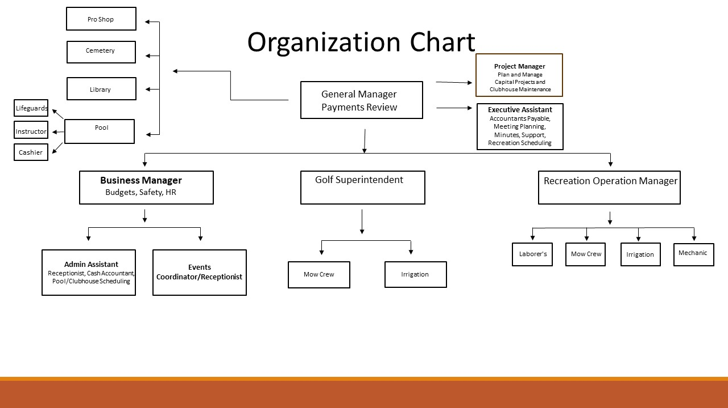

Slide 24

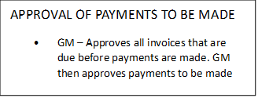
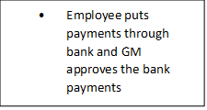

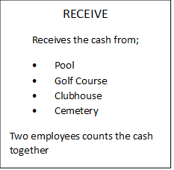

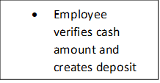
TYPES OF PAYMENTS MADE
Online (web portal)
Print Checks
Notifies GM of payments that need to be made through the bank via ACH
Order Request
PAYMENT REQUEST/MADE
Orders under $100.00
USER
Department Head Staff
ORDER
Executive Assistant
CASH

Slide 25
Other Operations
Disposal of Property Process Not Being Followed
  Items Given Away or Sent to Dump Without Proper Assessment/Review
  Loss of Potential Revenue or Use
Property Accountability Process Not In Place
Administrative Requirements Not Followed
  Not Logging Board Actions

Slide 26
Review of Financial Position
Clear that there would be a budget shortfall
Established protocol that tracked Personnel Costs and Revenue
  Appeared that a glide path to the end of August would be sufficient
  Ordered Equipment viewed as sunk costs
Crosswalk of Budget and Accounting Software showed differences
  While numbers from accounting software was used to create budget, the final budget created from a separate spreadsheet.
  Major budget shortfall Created by two factors
    Overestimate of tax income
    Overestimate of Golf Course Revenue
  Other contributing factors
    Lack of sufficient reserve
    Unforeseen Costs

Slide 27
Agency Budgeting Process
Developed By GM and Business Manager
Reviewed by Finance Committee
Approved By Board

Slide 28
Budgeting and taxation Schedule
Nov 2021 - Approved 2022 Budget
  Based on 2022 Taxes
Jan 2022 - Begin Budget Execution
Oct 2022 – Tax Increase Approved By Board
  Actually Done in December
Nov 2022 – 2023 Budget Approved Based on Tax Increase
  Revised 2022 Budget Approved By Board
Jan 2023 – Tax Increase Disallowed By State
  Revise 2023 Budget Based on New Projected Tax
Dec 2023 – Receive 2023 Taxes

Slide 29
2023 Property Tax Revenue
Budgeted Amount - $1,965,172
Actual Amount – $1,427,508

Slide 30
Golf Course Revenue
Year by Year Budgets
2019 | 2020 | 2021 | 2022 | 2023
$350,000.00 | $410,000.00 | $502,500.00 | $834,498.00 | $1,082,548.00
2022 Actuals
Reported - $749,215
Customer Credit - $71,655
Actual Revenue – $677,560
When adjusted for actual costs and current revenue in 2023 – Budget Revenue should be - $550,000

Slide 31
2022 Audit Results
Revenue – $3,898,422
  Tax -$1,504,366
  Fraud - $1,044,760
  Program Revenue - $1,298,452
    Charges for Services - $866,652
    Grants and Contributions - $431,800
      $30,000 – Grant for Parking Lot
      $401,800 – Impact Fees
Expenses - $3,520,554
Ending Balance - $2,081,564
  Actual Ending Balance - $1,745,858

Slide 32
PTIF Account Balances
Date | PTIF Balance
5/18 | $1,053,127
6/14 | $1,078,650
6/28 | $940,287
7/11 | $570,235
7/26 | $500,861

Slide 33
July Precipitating Factors
Increased rate of expenditures – primarily due to payment for costed items
Continued underperformance of the Golf Course
Required Emergency Rebudgeting Actions
  Accelerated Layoffs
  Deeper Cuts Required
  Cancellation of some scheduled Equipment

Slide 34
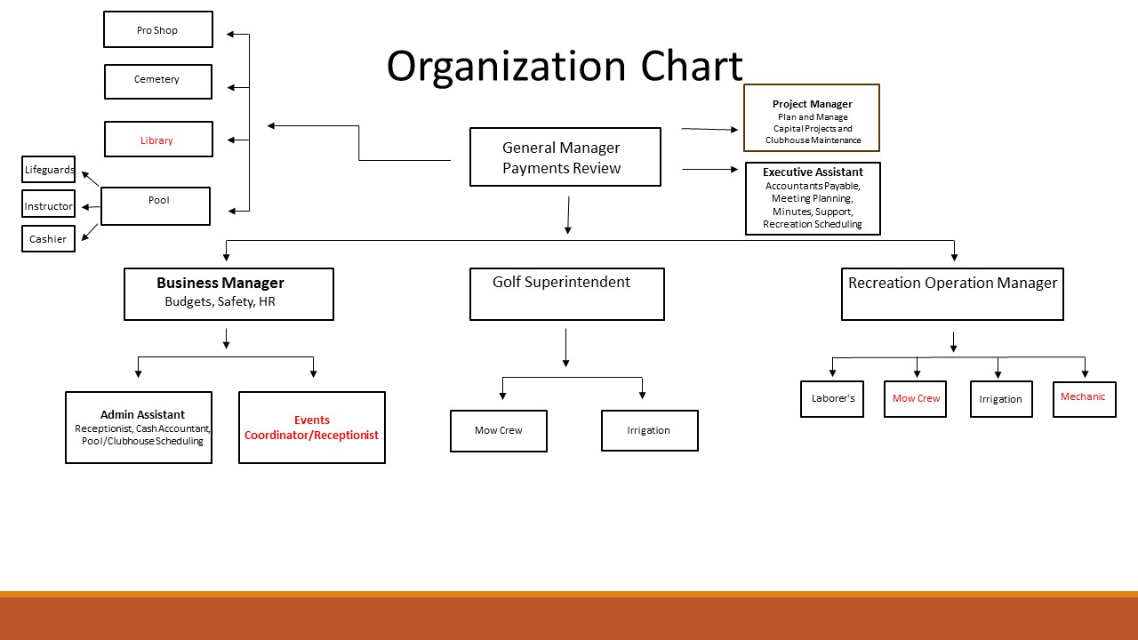

Slide 35
End of July Budget Summary
Bank accounts Balance
Employee Payroll
as of 7/31/2023
Capital Expense
Jan | $ 107,321.41
Feb | $ 79,046.98
Mar | $ 75,505.74
Apr | $ 163,925.59
May | $ 147,842.22
June | $ 126,694.28
July | $ 144,461.55
Total | $ 844,797.77
Golf Course Revenue
Pool Revenue

Slide 36
Findings
Internal Structure within Admin Section Muddled and Inefficient
  Corrected
Budget Updates Not Being Done As Required
Unclear Definition of Relationship Between Board and GM
Board Needs Tighter Management Controls Over Operation
  Personnel Staffing Requirements
  Monitoring Budgetary Actions

Slide 37
Recommendations
Increase surveillance of expenditures and revenue
  Current projected deficet - $200K
  Identification of further cuts
Board to consider options for bridge funding
Staff looking to Increase Revenue options
Shift some staff to Impact fee funding
  Limited options

Slide 38
Recommendations (cont'd)
Update contracting process and contracts
Better budgeting process
  Use of existing software to prepare budget
  Better awareness of key points by the board
  Suggest increased training on budgeting process
  Finance Committee More Active in Budgeting
Streamlined Reporting process
Better definition of GM roles and responsibility
Better public outreach
  Planned newsletter

Slide 39
Recommendations (cont’d)
Better Coordination with Library Board
  Need to establish a formal agreement
  Better define budget support
  County must be involved
Increased use of volunteer groups
  Lake Monitoring
  Tree surveillance and treatment
  Events planning and execution

Slide 40

Board Member Reports and Concerns

Slide 41
Meeting Adjourned

Slide 42
Closed Session as needed to discuss personnel, pending, or threatened litigation, or property acquisitions.

